Slide 1
Neural Networks

Slide 2
Backprop

Slide 3
Activation functions

Slide 4
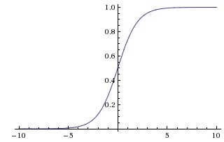
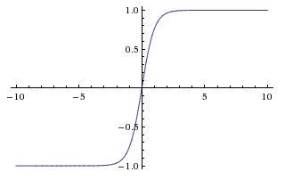
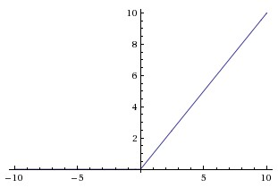
Types of activation function
Sigmoid
Tanh
ReLU
Every activation function (or non-linearity) takes a single number and performs certain fixed mathematical operation on it.
Images and text source: cs231n stanford

Slide 5
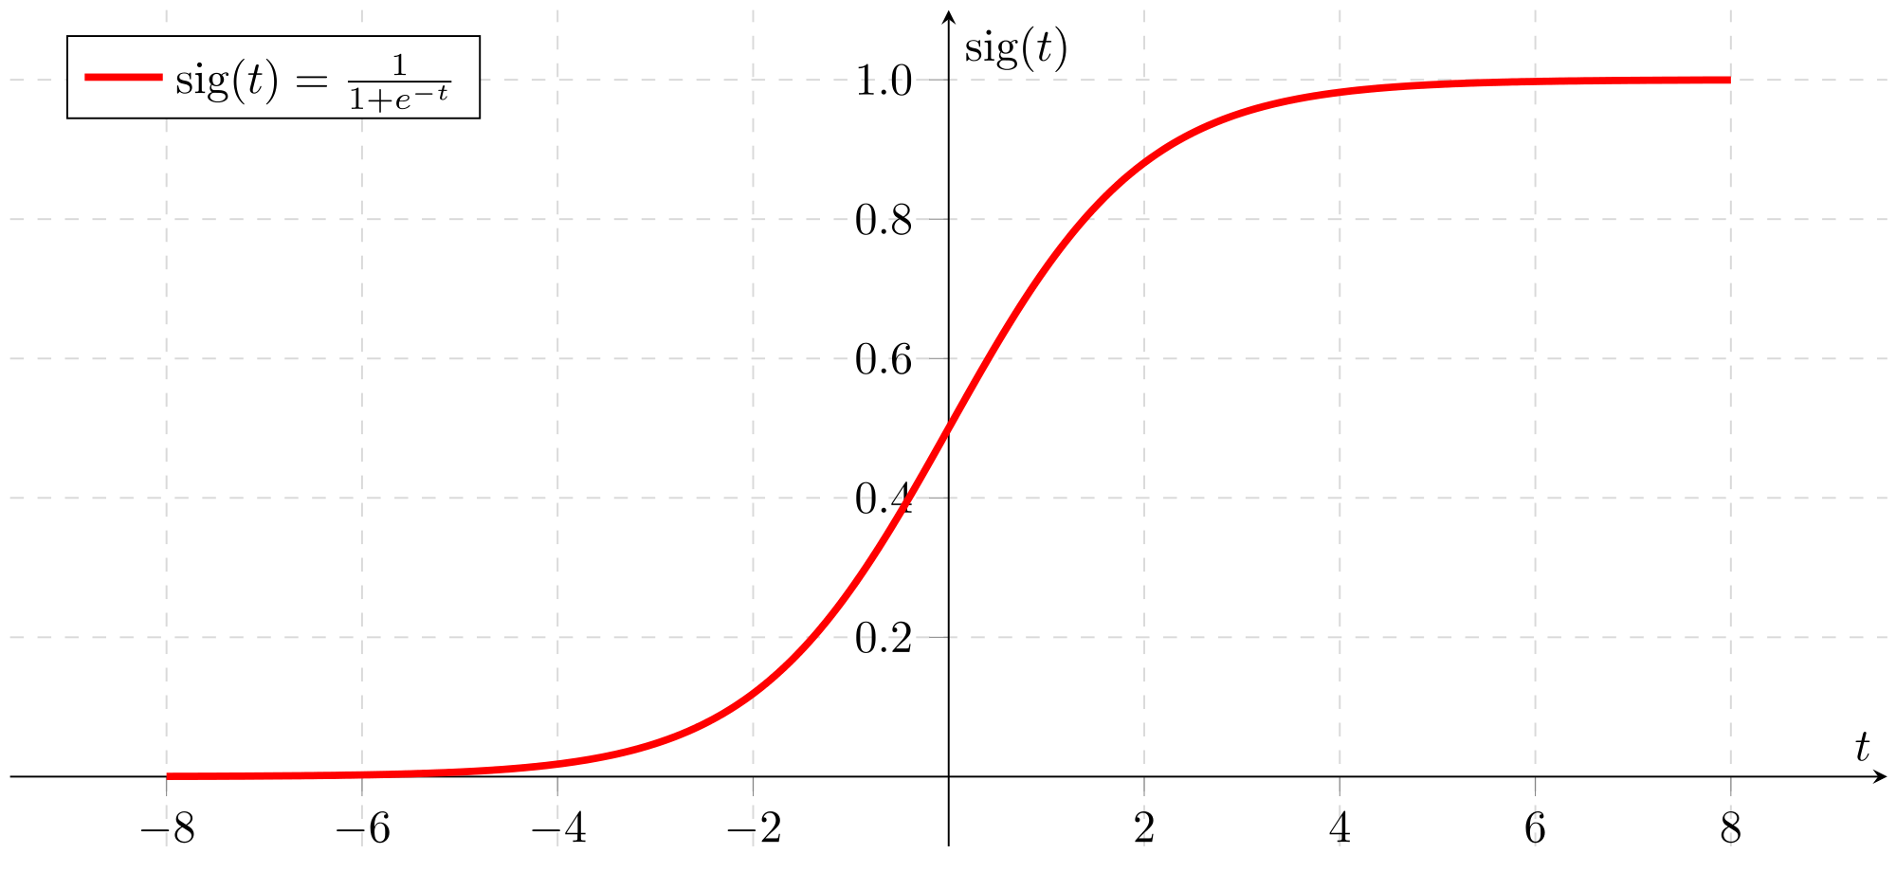
Sigmoid function
Activation function of form f(x) = 1 / 1 + exp(-x)
Ranges from 0-1
S-shaped curve
Historically popular
Interpretation as a saturating “firing rate” of a neuron
Drawbacks
Its output is not zero centered. Hence, make the gradient go too far in different directions
Vanishing Gradient Problem
Slow convergence
Image source: wikimedia

Slide 6
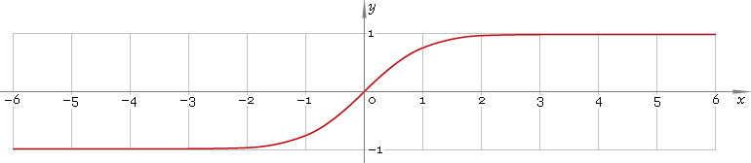
Tanh function
Drawbacks
Though optimisation is easier, it still suffers from the Vanishing Gradient Problem
Ranges between -1 to +1
Output is zero centered
Generally preferred over Sigmoid function
Image source: librow

Slide 7
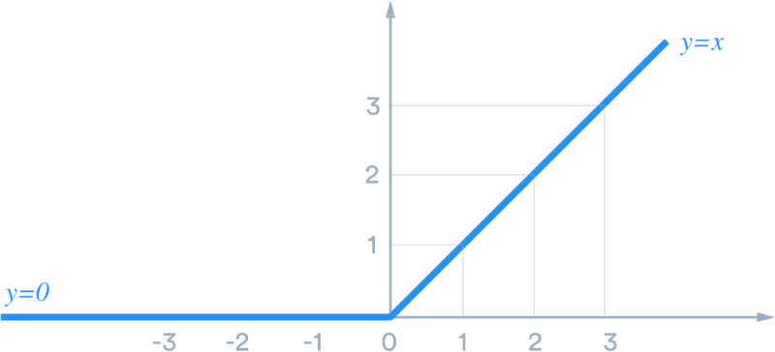
ReLU function
Very simple and efficient
Have 6x times better convergence than tanh and sigmoid function.
Very efficient in computation
Drawbacks
Output is not zero centered.
Should only be used within hidden layers of a NN model
Image source: medium

Slide 8
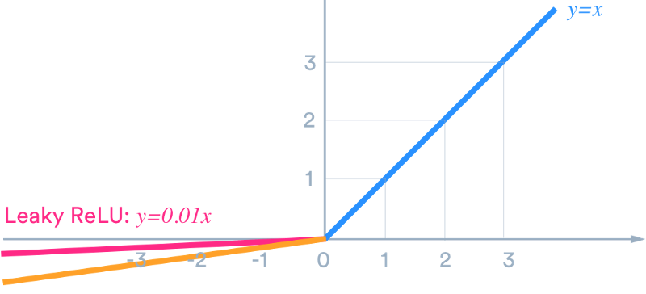
Leaky ReLU function
Leaky ReLU was introduced to overcome the problem of dying neurons.
Leaky ReLU introduces a small slope to keep the neurons alive
Does not saturate (in +region)
Image source: medium

Slide 9
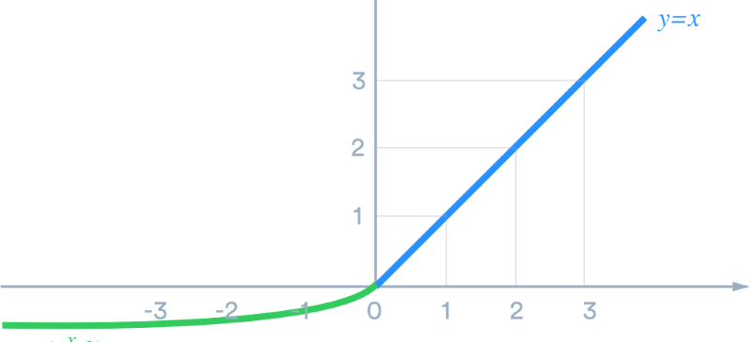
ELU function
ELU function tend to converge cost to zero faster and produce more accurate results
Closer to zero mean outputs
Has a extra alpha constant which should be positive number
ELU is very similar to RELU except negative inputs
Have all advantages of ReLU
Drawbacks
Computation requires exp()
Image source: medium

Slide 10
Fully-connected layer

Slide 11
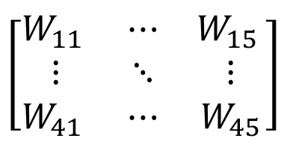



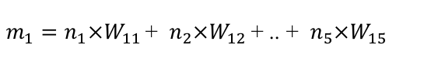
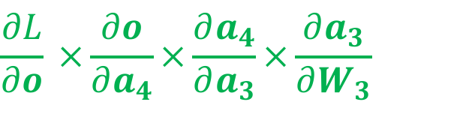



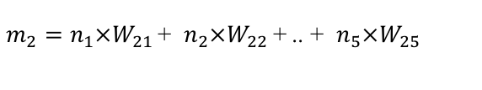


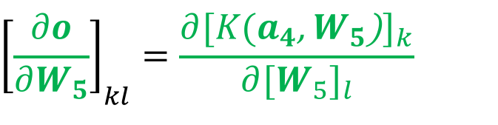
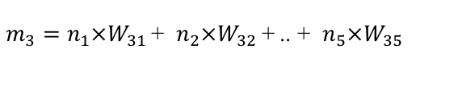
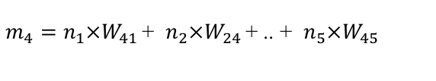
Fully connected layer

Slide 12
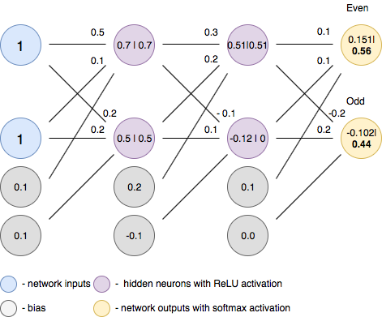
FC layer - forward pass
Forward pass is basically a set of operations which transform network input into the output space. During the inference stage neural network relies solely on the forward pass.
Images and text source: towardsdatascience

Slide 13
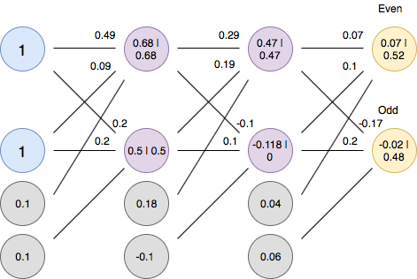
FC layer - backward pass
Backpropagation is an algorithm which calculates error gradients with respect to each network variable (neuron weights and biases). Those gradients are later used in optimization algorithms, such as Gradient Descent, which updates them correspondingly. The process of weights and biases update is called Backward Pass.
Images and text source: towardsdatascience

Slide 14
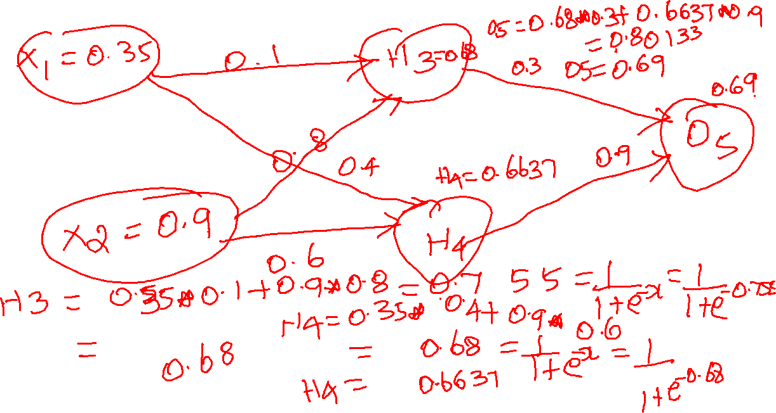
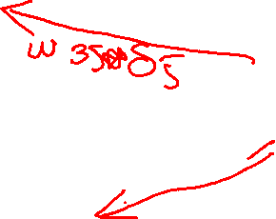

Slide 15
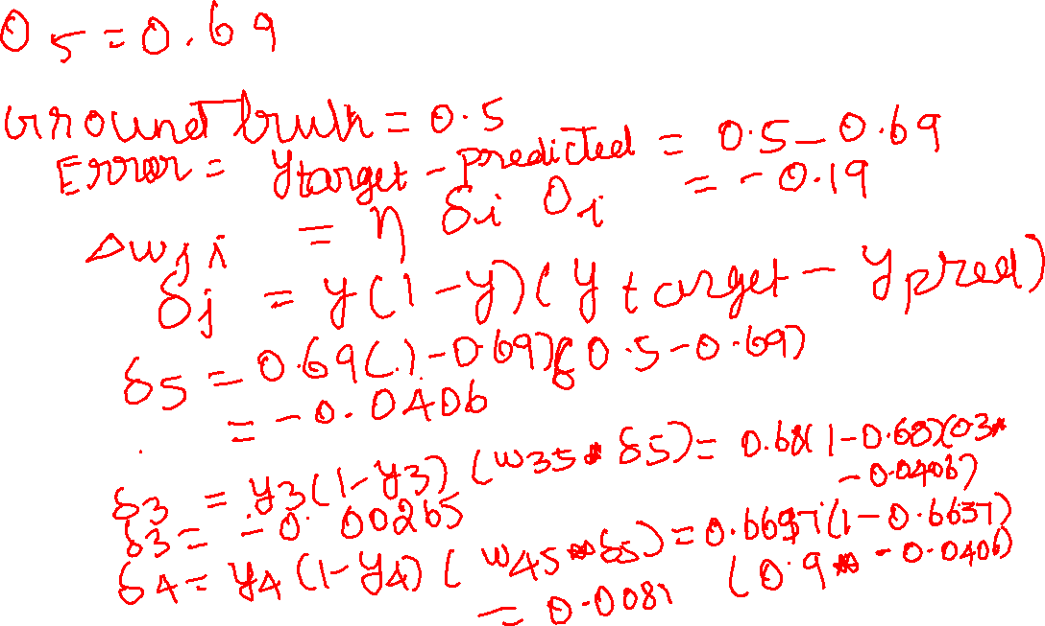

Slide 16
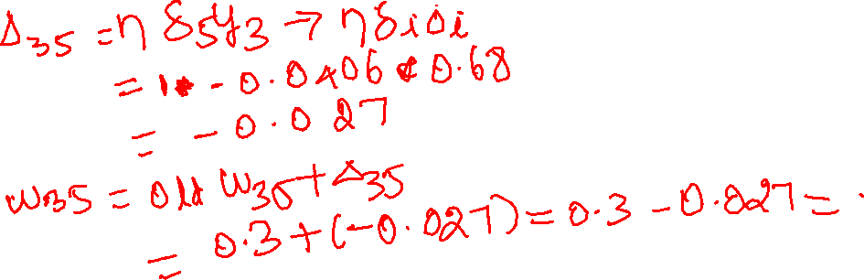
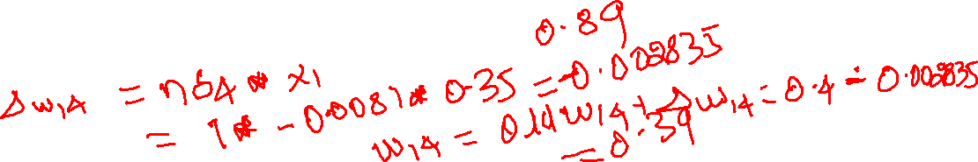
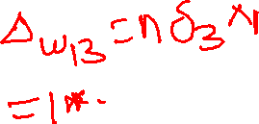
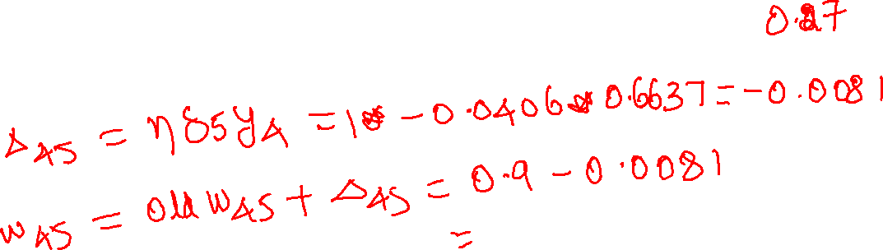

Slide 17
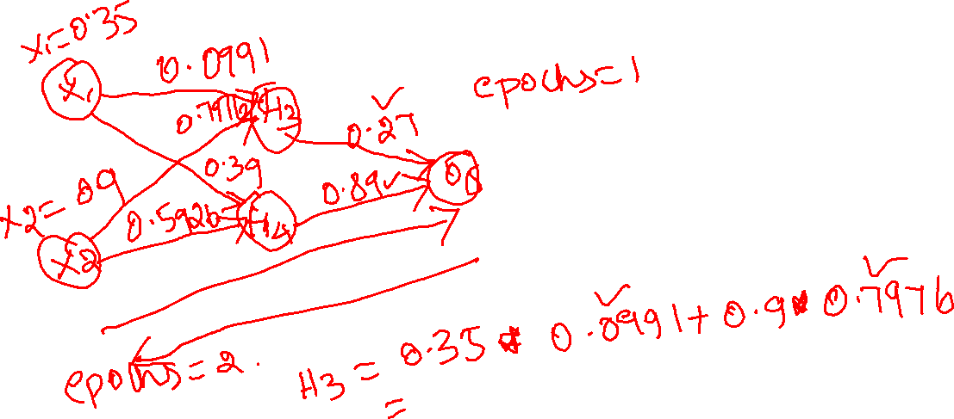

Slide 18
Softmax function

Slide 19
Softmax
Softmax function is a multinomial logistic classifier, i.e. it can handle multiple classes
Softmax typically the last layer of a neural network based classifier
Softmax function is itself an activation function, so doesn’t need to be combined with an activation function

Slide 20
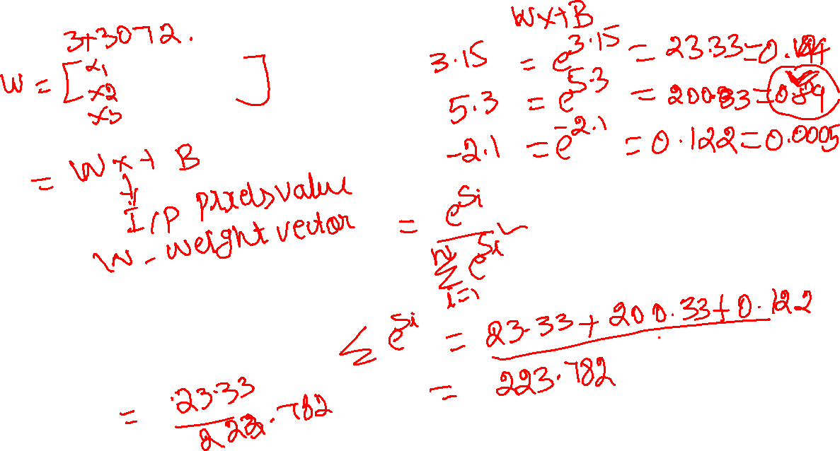

Slide 21
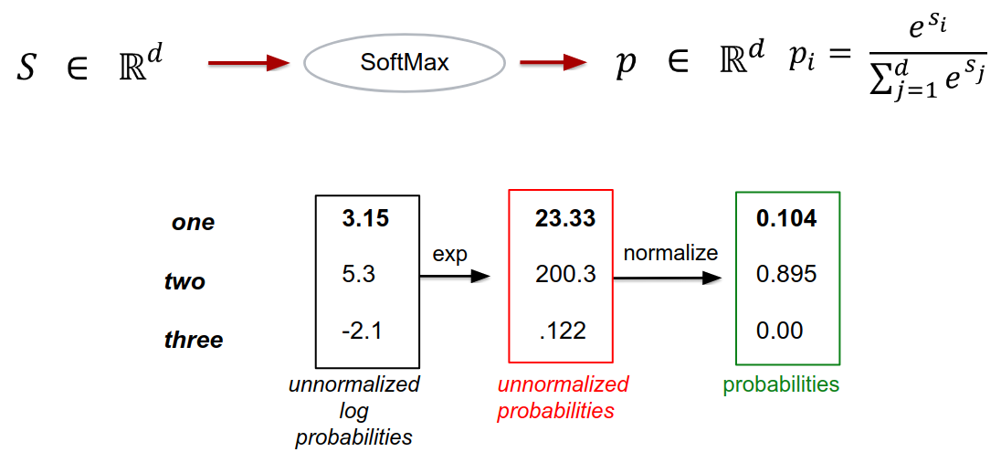
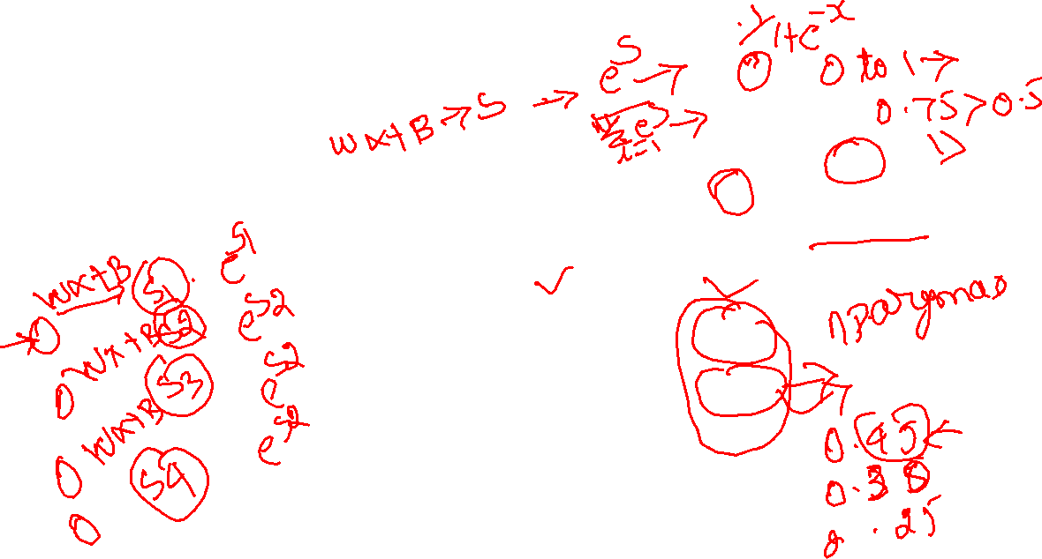
Softmax

Slide 22
Cross-entropy loss

Slide 23
Cross-entropy loss
Cross-entropy loss (often called Log loss) quantifies our unhappiness for the predicted output based on its deviation from the desired output
Perfect prediction would have a loss of 0
With gradient descent, we try to reduce this (cross-entropy) loss for a classification problem

Slide 24
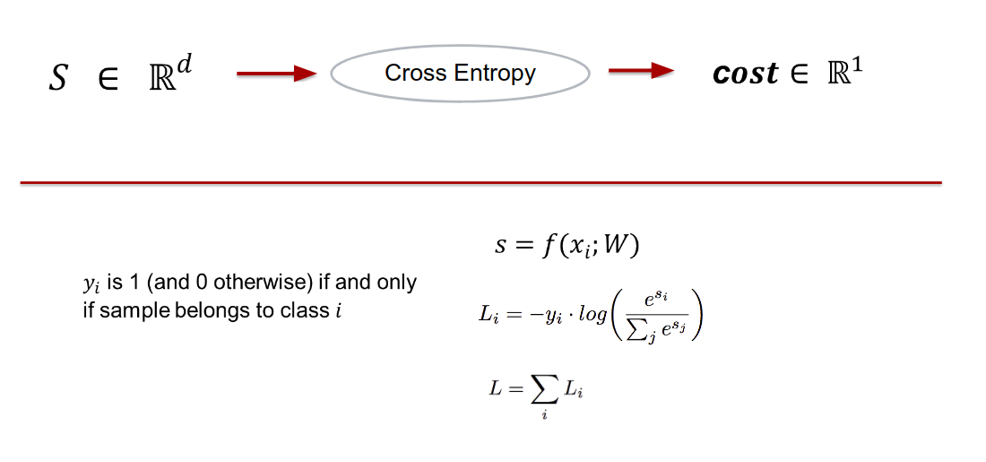
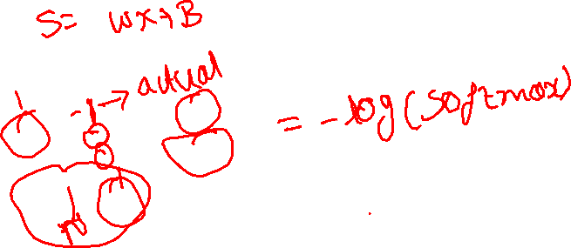
Cross-entropy loss

Slide 25
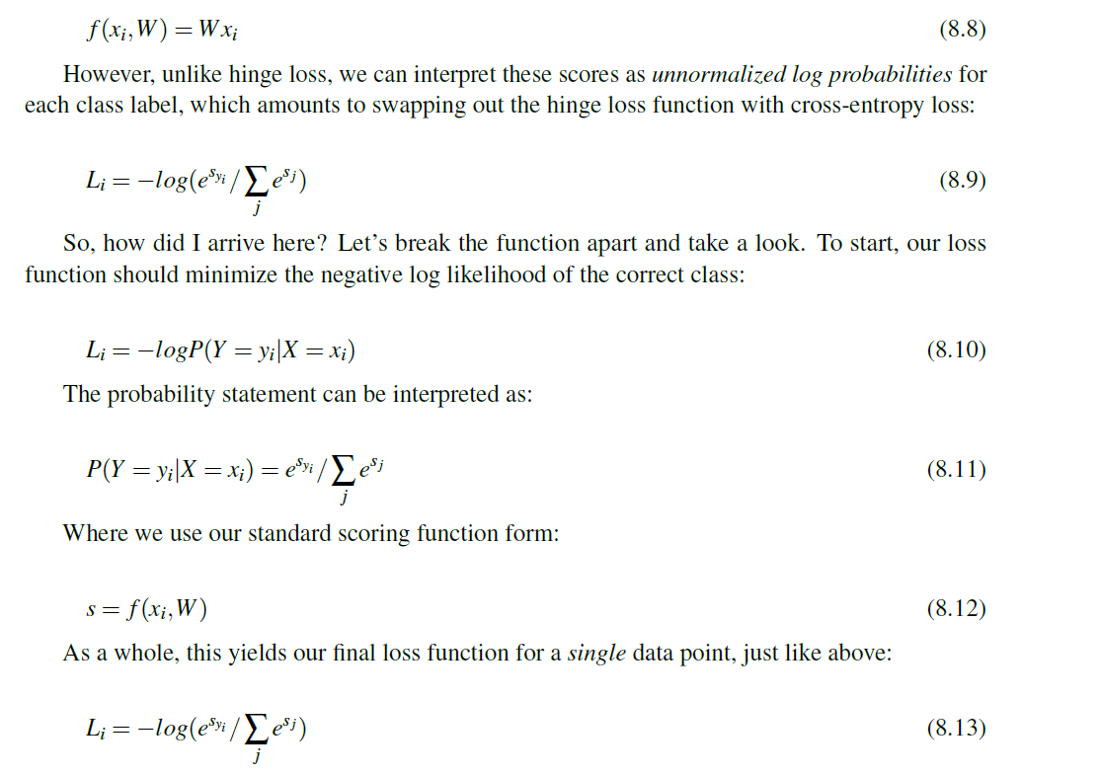
Cross Entropy Loss

Slide 26
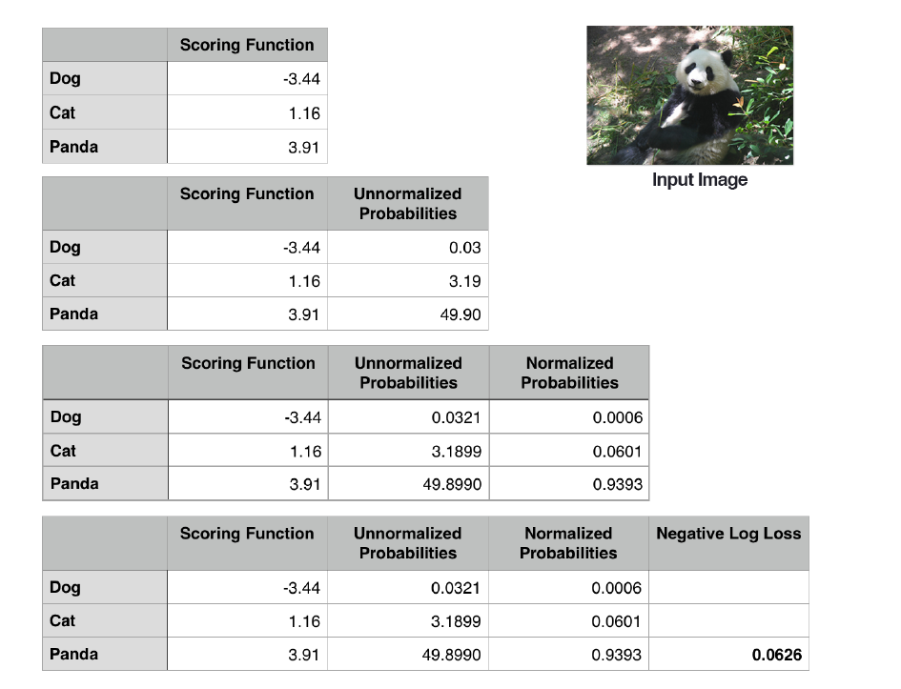
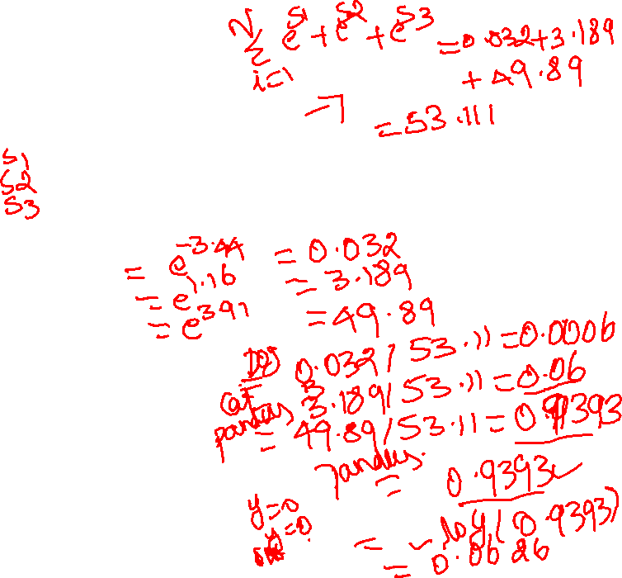
Cross Entropy Loss

Slide 27
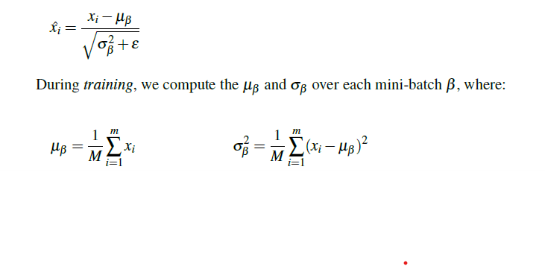
Batch Normalization

Slide 28
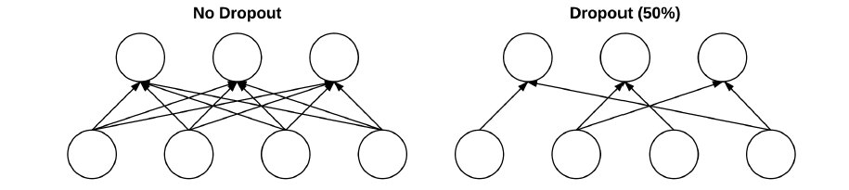
Dropout

Slide 29
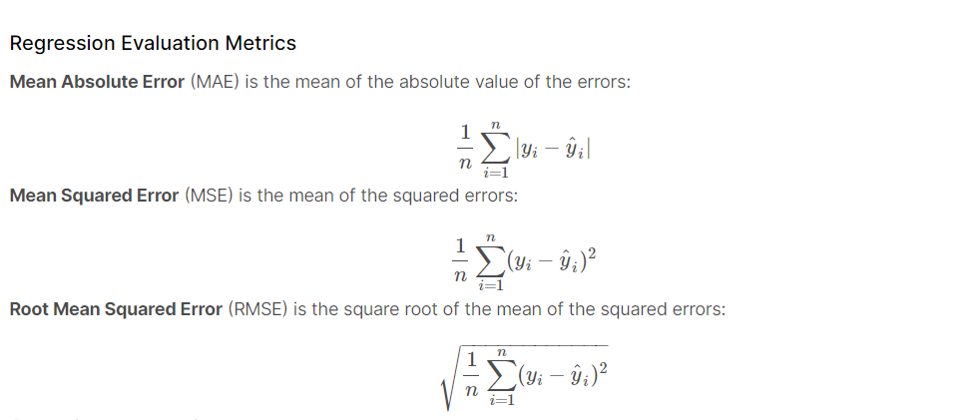
Regression Metrics

Slide 30
Summary

